Slide 1
Optical communications and data networks (EENGM2001) Week14_Lecture010_ASync_APD
Siddarth K Joshi

Slide 2
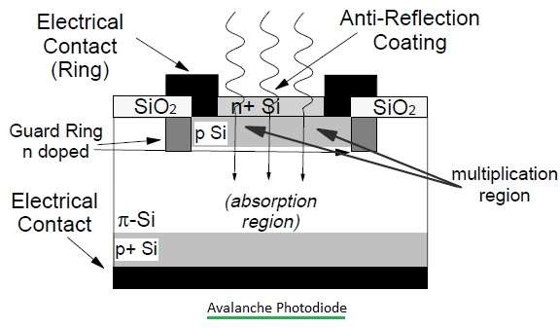
APD
Another type of photodiode
APD = Avalanche Photo Diode
p⁺
i
n⁺
p
-
+
Avalanche gain region
E-field
d
High e-field in additional p layer
Electrons accelerated by high e-field
creates more electrons by ‘Impact ionisation’

Slide 3
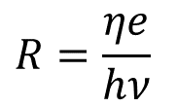
APD
Responsivity of APD
Avalanche gain M strongly depends on bias voltage (field) and temperature
Typical telecomms APD needs reverse bias of 10-50 V for M ~ 10
Also needs automatic bias stabilisation to prevent break-down
For a PIN diode we saw this is
$$R=\frac{ηe}{hν}$$

Slide 4
APD Vs PIN
APD
High responsivity
V. High bias voltage
High dark current
V. High sensitivity
Can easily be damaged by improper use
Low damage threshold
Needs biasing control
PIN
>10 times lower responsivity
Low bias voltage (easy operation)
Low dark current (less noise)
Lower sensitivity (needs brighter signal)
Reliable
V. High damage threshold
Constant bias

Slide 5
APD Vs PIN
APD
High responsivity
V. High bias voltage (~150V)
High dark current
V. High sensitivity
Can easily be damaged by improper use
Low damage threshold
Needs biasing control
Slower response time
Expensive
High SNR
PIN
>10 times lower responsivity
Low bias voltage (easy operation)
Low dark current (less noise)
Lower sensitivity (needs brighter signal)
Reliable
V. High damage threshold
Constant bias
Almost twice as fast
Cheap
Much lower SNR

Slide 6
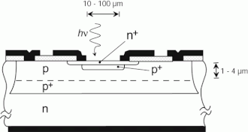
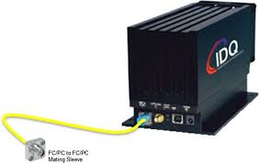
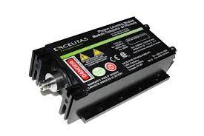
SPAD
Single Photon Avalanche Diode
APD with V. large E field >> Breakdown
(~1E6V/cm)
Just one electron hole pair triggers an avalanche to generate mA of current.
Needs quenching

Slide 7
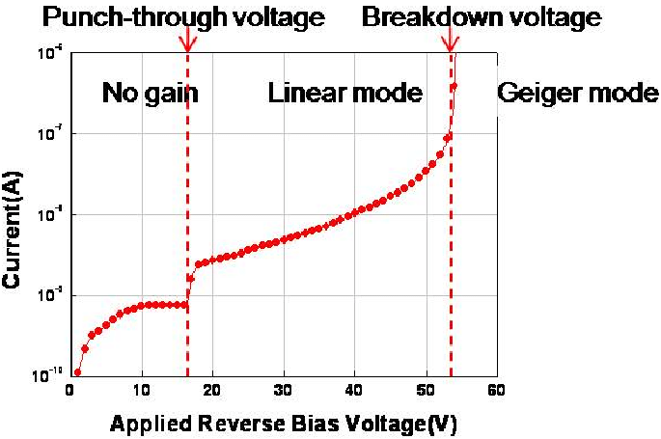
SPAD
Works like a photodiode
SPAD like behaviour
Without quenching, the avalanche will continue
APD like behaviour

